Slide 1
Lecture 24
Unit6- Human Communities and the Environment
(Human population growth: Impacts on environment, human health and welfare)
1

Slide 2
Learning outcomes:
After completing this lecture, you will be able to understand the following:
Get knowledge about various important term used for the study of population growth.
Get awareness about Population growth, causes and effects of population growth on human and environment.
2

Slide 3

Human Communities and the Environment
3

Slide 4
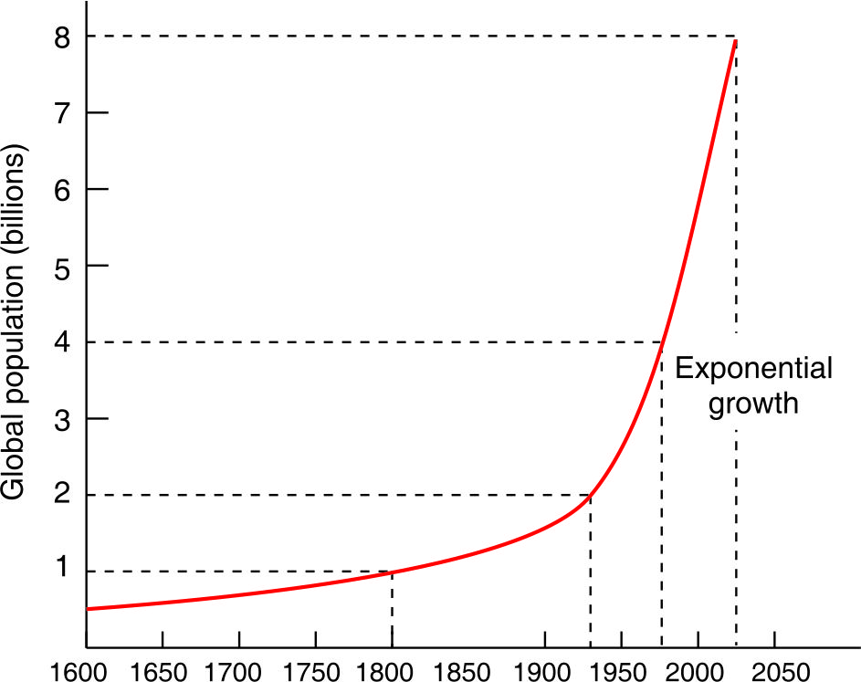
Human Population Growth: The increase in the number of individuals in a population is known as population growth.
The study of human population trends is called demography.
Population growth was slow and stable till 1900, but a dramatic exponential growth occurred after 1930’s following technological growth.
Fig. Global population growth trends in the last four centuries
4

Slide 5
Factors Influencing Population Size
Exponential growth: Population growth takes place exponentially and that explains the dramatic increase
Doubling time: The time needed for a population to double its size at a constant annual rate is calculated
Td = 70/r
where Td = Doubling time in years
r = annual growth rate
If a nation has 2% annual growth rate, its population will double in 35 years.
5

Slide 6
Total Fertility Rates (TFR): Fertility rates measures the average number of children per woman. The value of TFR varies from 1.9 in developed nations to 4.7 in developing nations.
Infant mortality is the death of young children under the age of 1.This death toll is measured by the infant mortality rate (IMR).
Infant mortality rate (IMR):- Infant mortality rate is the probability of deaths of children under one year of age per 1000 live births Infant mortality rate:
6

Slide 7
Replacement level:
Replacement level fertility is the total fertility rate—the average number of children born per woman—at which a population exactly replaces itself from one generation to the next, without migration.
For developing nations, where infant mortality is high and life expectancy is low, the replacement level is approx. 2.7, whereas in developed nations it is 2.1
https://www.youtube.com/watch?v=BNSC10BksBs
7

Slide 8
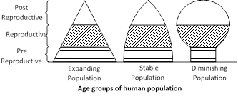
Age structure: pre-reproductive (0-14 years), reproductive (15-44 years) and post reproductive (45 years and above).
8

Slide 9

Three types of age pyramids are used for explaining age structure.
• Pyramid shaped
• Bell shaped
• Urn shaped
9

Slide 10
Population Explosion
The unprecedented growth of human population at an alarming rate is referred to as population explosion.
India has 1.21 billion people.
it will have 1.63 billion people by 2050
The Population Clock
Every second, on an average 4.3 children are born and 2 people die, thus resulting in net gain of nearly 2.3 persons everyday by 2,08,400 persons.
https://www.youtube.com/watch?v=PIZyHMUGdq0
10

Slide 11
Factors Deciding the Growth or Decline of Population
Birth Rate-Number of births per thousand people in a geographical area. Birth rate of the world is 22.69 births per 1,000 people. Birth vary between developed and developing countries.
Death rate-Number of deaths per thousand people in a geographical area. Death rate of the world is 6.58 deaths per 1,000 people . Advances in medicinal field resulted in lesser number of deaths.
Migration -Rate of population change for a specific area.
11

Slide 12
Causes of Population Growth
Major caused of population growth are given as:
Availability of cure for many life-threatening diseases
Preference for sons
Lower infant mortality
Custom of early marriages
Improvement in public health
Illiteracy
12

Slide 13
Effects of population explosion on environment, Human Health & Welfare
Severe resource depletion and environmental degradation.
Limited resources like land, water, fossil fuels, minerals etc. are getting exhausted.
Renewable resources like forests, grasslands etc. are under tremendous pressure.
Industrial and economic growth are raising our quality of life but adding toxic pollutants into the air, water and soil.
13

Slide 14
Effects of population explosion on environment, Human Health & Welfare conti………………..
Ecological life-support systems are getting jeopardized.
• Human health is influenced by many factors like nutritional, biological, chemical or psychological, which are related to environment.
• Infectious organisms: Disease-causing organisms pose greater environmental threats to health, more severely in the developing countries especially the tropical ones.
14

Slide 15
Effects of population explosion on environment, Human Health & Welfare conti………………..
• Microbes can cause food poisoning by producing toxins in the contaminated food. Some moulds grow on food and produce poisonous toxins.
• Infectious organisms can cause respiratory diseases (pneumonia, tuberculosis, influenza etc.) and gastrointestinal diseases (diarrhea, dysentery, cholera etc.).
15

Slide 16
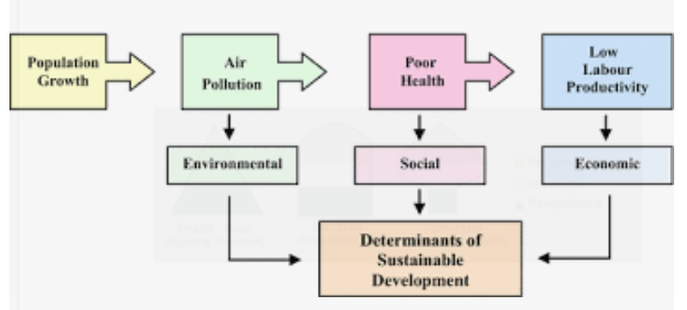
https://www.youtube.com/watch?v=B7lrCMoZKUU
16

Slide 17
Important Web-Links-Lecture 24
Reading Material
http://collegesat.du.ac.in/UG/Envinromental%20Studies_ebook.pdf
https://www.ugc.ac.in/oldpdf/modelcurriculum/Chapter7.pdf
Audio visuals
https://www.youtube.com/watch?v=fTznEIZRkLg
17

Slide 18
Acknowledgment
Some images, animation, and material have been taken from the following sources:
1- Text Books: PERSPECTIVE IN ENVIRONMENTAL STUDIES by ANUBHA KAUSHIK, C P KAUSHIK, NEW AGE INTERNATIONAL PUBLISHERS
2- References Book: TEXT BOOK OF ENVIRONMENTAL STUDIES by D. DAVE AND S. S. KATEWA, CENGAGE LEARNING
3- All slides can be used for reading purpose only
18

